Slide 1

Sensitive Surveys Analysis with LLMs

Slide 2
AXA conducts annual surveys to assess workplace inclusion and diversity, focusing on identifying non-inclusive behaviors.
Risk
66 000 participants
In 2024, 66 000 AXA employees around the world participated in the survey. The survey generated 15 000 verbatim (open-ended responses)
Human error: Employees might unintentionally disclose sensitive information when handling the data
Time consuming manual analysis: Even with key word search application, analyzing the verbatim usually take several days for the team to review them entirely
15 000 verbatim
The survey includes questions on witnessing or experiencing racism, sexism, and other forms of discrimination
Sensitive Information
Group HR Inclusion & Diversity (I&D) team then analyze each discrimination theme to extract key pain points and guidelines from employees’ feedback

Slide 3



AXA faced tight deadlines to process 15,000 verbatims within a tight deadline, while ensuring absolute confidentiality of employee responses
LLM as survey analyzers
Security by design
Human in the loop
Verbatim were processed using GPT-4o processed verbatims to predict their theme (discrimination) and sentiment
Topic modeling was performed to discover new I&D themes
Using GPT-4o large input context window, reports by themes were produced
The survey analysis application uses the internal LLM models of AXA through Secure GPT to minimize the risk of data leakage
Inclusion & Diversity specialists were involved to review the model outputs and help the team optimize the prompts
The Survey analysis application also produced statistics by themes and sentiment
Notes:
Sources:
https://masterofcode.com/blog/chatgpt-statistics
AI and ChatGPT can help insurers improve the claims experience (lifeinsuranceinternational.com)

Slide 4

AKABI Implemented a strategy using LLM models to securely process verbatims efficiently
Business Impact
99%
Enhanced Employee Engagement: The survey analyzer can identify biases and trends in survey responses, leading to proactive improvements in the workplace environment and increased employee retention.
Informed Decision-Making: The system provides predictive analytics enabling HR teams to anticipate future diversity needs and make quicker, data-driven decisions.
HR Process Optimization: Automating survey data analysis frees up HR resources for strategic tasks, while reducing bias in recruitment processes to promote a diverse workforce.
Strategic Cultural Impact: The tool’s insights help foster an inclusive culture, aligning company practices with diversity, equity, and inclusion (DEI) goals, enhancing the company’s attractiveness as an employer.
Percentage of verbatims correctly translated in English by the model for subsequent processing
Reduce from days to a few hours the time to analyze the verbatim while preserving privacy
98%
Accuracy of the system to detect Inclusion & Diversity themes of the verbatim

Slide 5






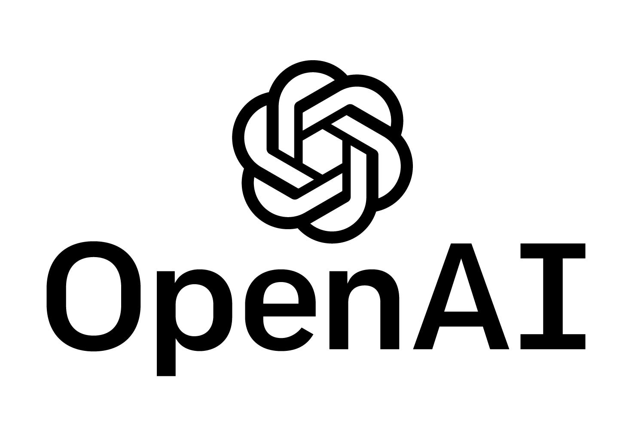


Inclusion & Diversity verbatim classification
1x Medior Data Scientist (4 months)
Python JupyterLab LLM (Large Language Model)

